Slide 1
EMPLOYEES DATA ANALYSIS WITH EXCEL
Student Name : DHANYA SAGAYAMARY G
Register No : 312211711
Department : B.com (GENERAL)
COLLEGE : THIRUTHANGAL NADAR COLLEGE

Slide 2
PROJECT TITLE
Using pivot tables for employee turnover ratio

Slide 3
AGENDA
Problem statement
Project overview
End user
Our solution and proposition
Data description
Modeling approach
Result
Discussion
Conclusion

Slide 4
PROBLEM STATEMENT
Analyse employee turnover trends to identify key factor contributing to turnover, enabling data driven retention strategies

Slide 5
PROJECT OVERVIEW
Utilize pivot tables to examine employee turnover data, uncovered pattern and provide actionable insights for HR and management

Slide 6
END USER
HR professionals , Management, business leaders and analysts seeking to understand and address employee turnover.

Slide 7
OUR SOLUTION AND PROPOSITION
Leverage pivot tables to transform Complex turn over data into easily digestible insights enabling data driven decisions and improved the Retention strategies

Slide 8
DATA DESCRIPTION
Employee turnover data including
Employee ID
Department
Job title
Tenure
Reason for leaving

Slide 9
MODELING APPROACH
Calculate turnover rates
Identify top reasons for leaving
Analyse trends in turnover overtime
Filter and drill down into specific data segment

Slide 10
Results
EmpID | FirstName | LastName | StartDate | ExitDate | Title | Supervisor | ADEmail | BusinessUnit | EmployeeStatus | EmployeeType | PayZone | EmployeeClassificationType | TerminationType | TerminationDescription | DepartmentType | Division | DOB | State | JobFunctionDescription | GenderCode | LocationCode | RaceDesc | MaritalDesc | Performance Score | Current Employee Rating
3427 | Uriah | Bridges | 20-Sep-19 |  | Production Technician I | Peter Oneill | uriah.bridges@bilearner.com | CCDR | Active | Contract | Zone C | Temporary | Unk |  | Production | Finance & Accounting | 07-10-1969 | MA | Accounting | Female | 34904 | White | Widowed | Fully Meets | 4
3428 | Paula | Small | 11-Feb-23 |  | Production Technician I | Renee Mccormick | paula.small@bilearner.com | EW | Active | Contract | Zone A | Part-Time | Unk |  | Production | Aerial | 30-08-1965 | MA | Labor | Male | 6593 | Hispanic | Widowed | Fully Meets | 3
3429 | Edward | Buck | 10-Dec-18 |  | Area Sales Manager | Crystal Walker | edward.buck@bilearner.com | PL | Active | Full-Time | Zone B | Part-Time | Unk |  | Sales | General - Sga | 06-10-1991 | MA | Assistant | Male | 2330 | Hispanic | Widowed | Fully Meets | 4
3430 | Michael | Riordan | 21-Jun-21 |  | Area Sales Manager | Rebekah Wright | michael.riordan@bilearner.com | CCDR | Active | Contract | Zone A | Full-Time | Unk |  | Sales | Finance & Accounting | 04-04-1998 | ND | Clerk | Male | 58782 | Other | Single | Fully Meets | 2
3431 | Jasmine | Onque | 29-Jun-19 |  | Area Sales Manager | Jason Kim | jasmine.onque@bilearner.com | TNS | Active | Contract | Zone A | Temporary | Unk |  | Sales | General - Con | 29-08-1969 | FL | Laborer | Female | 33174 | Other | Married | Fully Meets | 3
3432 | Maruk | Fraval | 17-Jan-20 |  | Area Sales Manager | Sheri Campos | maruk.fraval@bilearner.com | BPC | Active | Contract | Zone B | Full-Time | Unk |  | Sales | Field Operations | 03-04-1949 | CT | Driver | Male | 6050 | Black | Married | Fully Meets | 3
3433 | Latia | Costa | 06-Apr-22 | 03-Jul-23 | Area Sales Manager | Jacob Braun | latia.costa@bilearner.com | WBL | Active | Full-Time | Zone B | Temporary | Involuntary | Me see picture nature degree benefit. | Sales | General - Eng | 01-07-1942 | CA | Technician | Female | 90007 | Hispanic | Divorced | Exceeds | 4
3434 | Sharlene | Terry | 06-Nov-20 | 29-Jan-23 | Area Sales Manager | Tracy Marquez | sharlene.terry@bilearner.com | CCDR | Active | Contract | Zone C | Full-Time | Involuntary | Blue community type skill story. | Sales | Engineers | 07-03-1957 | OR | Engineer | Female | 97756 | White | Divorced | Fully Meets | 2
3435 | Jac | McKinzie | 18-Aug-18 |  | Area Sales Manager | Sharon Becker | jac.mckinzie@bilearner.com | NEL | Active | Contract | Zone B | Part-Time | Unk |  | Sales | Executive | 15-05-1974 | TX | Executive Assistant | Male | 78789 | Black | Widowed | Exceeds | 3
3436 | Joseph | Martins | 21-Jan-22 | 29-Jun-23 | Area Sales Manager | George Jenkins | joseph.martins@bilearner.com | BPC | Active | Part-Time | Zone B | Temporary | Resignation | Summer personal bag. | Sales | Engineers | 11-11-1949 | TX | Engineer | Male | 78207 | Asian | Widowed | Fully Meets | 5

Slide 11
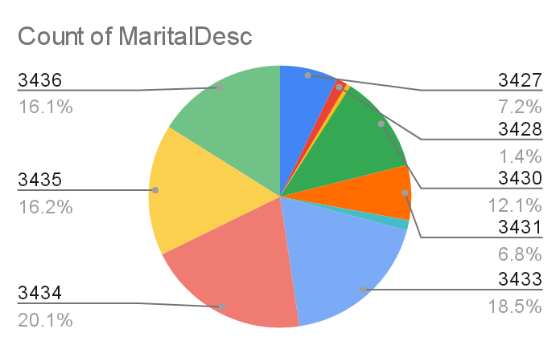
RESULT : PIE CHART

Slide 12
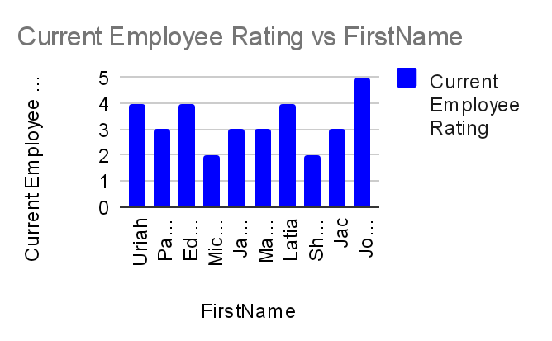
BAR DIAGRAM

Slide 13
DISCUSSION
Interpret result , highlighting key Trends high insights and implications for retention strategies discuss areas for further analysis and potential intervention

Slide 14
CONCLUSION
Summaries the value of using pivot tables for employee turnover analysis emphasize actionable insights data driven decision making and improved retention strategies

